Slide 1

Student End of Year Survey
Use our new Survey PowerPoint Add-In to solicit feedback about MobLab implementation in the classroom.
Compatible on PowerPoint 2016 or Later

Slide 2

How to Use MobLab Surveys in PPT
No screen switching for instructors
  Log into your instructor account on one MobLab slide
  Choose the class in the top bar
  Press run to begin, finish to end
  Survey data stored in your account under PPT playlist
Same functionality for students
  Students enter MobLab on their device
  Join the PPT Playlist
  Questions will become available when instructor presses run

Slide 3
Learning is all about Feedback
Why MobLab?
  Builds an emotional connection with the material
  Shows an empirical basis for theories we discuss
  Encourages thinking like economists
  It’s more fun
Student feedback evaluates if these goals have been reached in our classroom and how we can improve the experience
  Thank you for answering the following 5 questions

Slide 4
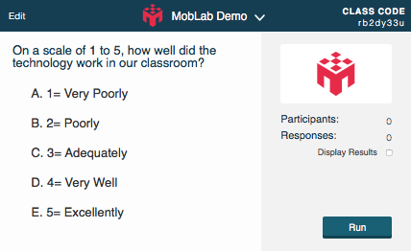
Question 1

Slide 5
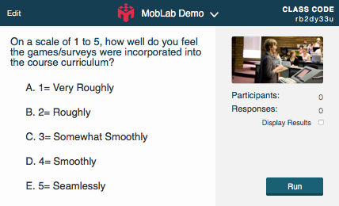
Question 2

Slide 6
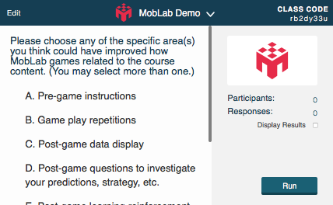
Question 3

Slide 7
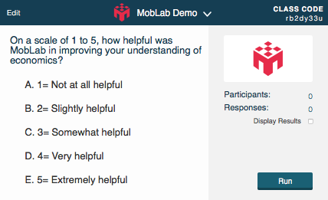
Question 4

Slide 8
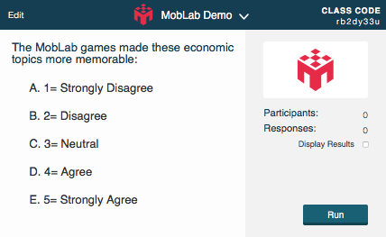
Question 5

Slide 9
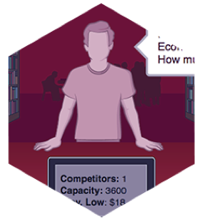
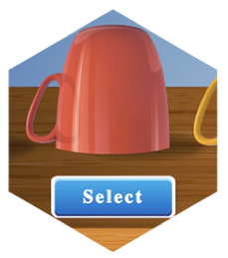


Thank You!
Have additional feedback?
Email us at contact@moblab.com with the subject line: End of Year Survey. Featured comments will receive a $5 amazon gift card.

